Slide 1

Blockchain Technology: A Comprehensive Overview
Blockchain technology is a revolutionary innovation that has the potential to transform various industries. It is a distributed ledger that securely records and verifies transactions across a network of computers.

Slide 2
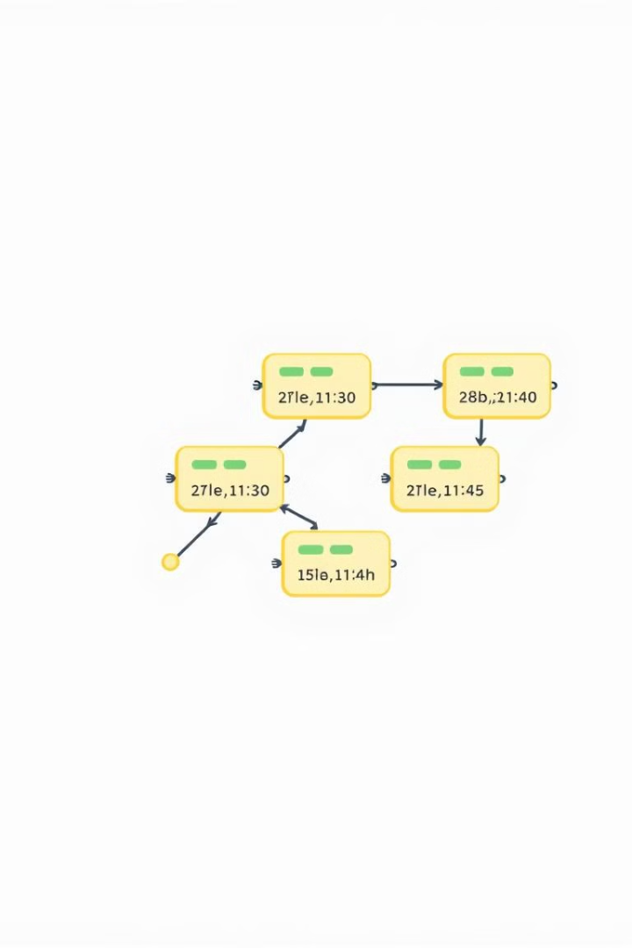
The Basics of Blockchain
1
Distributed Ledger
2
Immutability
A shared record of transactions maintained by multiple participants across a network.
Once a transaction is recorded on the blockchain, it cannot be altered or deleted.
3
Transparency
4
Security
All transactions on the blockchain are publicly viewable, providing transparency and accountability.
Cryptographic techniques and consensus mechanisms ensure the security and integrity of the blockchain.

Slide 3
Key Blockchain Concepts
Blocks
Hashing
Consensus
Data packets containing transactions, timestamps, and other information. They are linked together to form the blockchain chain.
A cryptographic function used to generate unique fingerprints of data, ensuring the integrity and authenticity of transactions.
A mechanism that allows network participants to agree on the validity of transactions and the state of the blockchain.

Slide 4
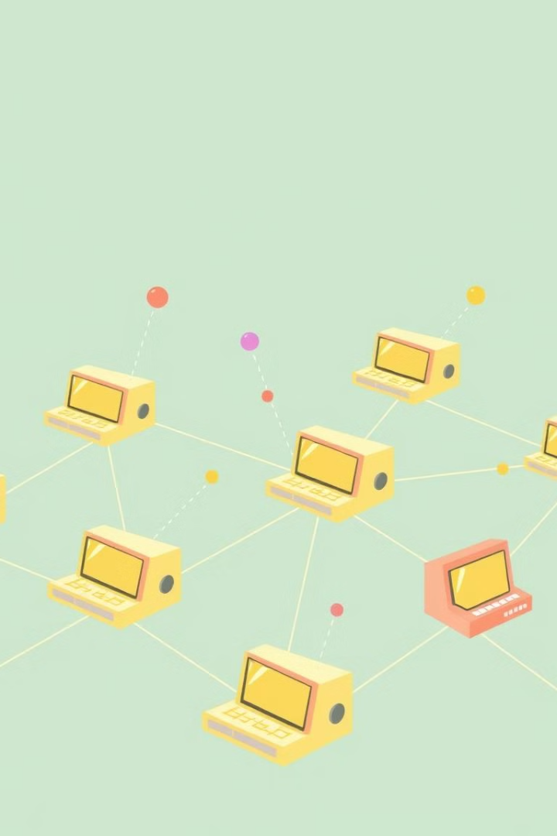
Decentralization and Distributed Ledgers
1
Centralized System
Data is controlled by a single entity, such as a bank or government.
2
Decentralized System
Data is distributed across multiple nodes, eliminating the need for a central authority.
3
Distributed Ledger
A shared database maintained by a network of computers, ensuring transparency and security.

Slide 5
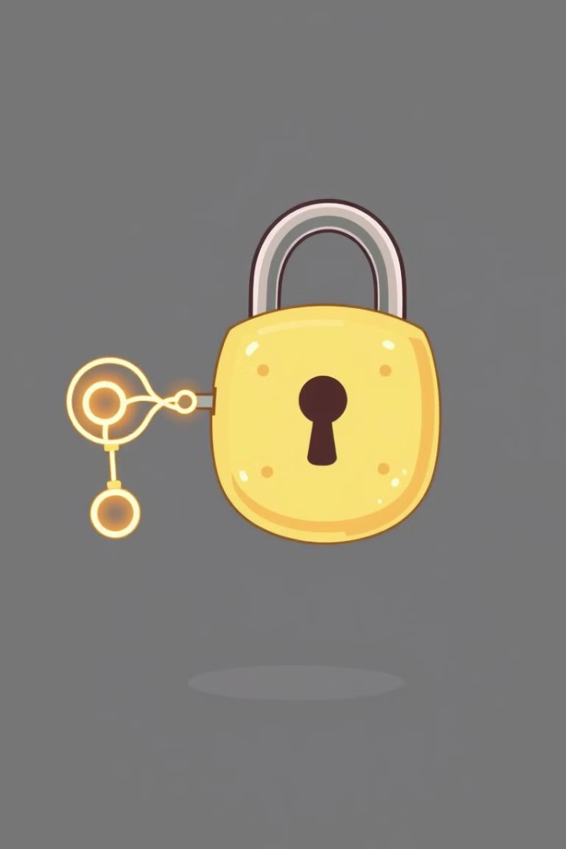



Cryptography and Blockchain Security
Public-key Cryptography
A system that uses a pair of keys - a public key and a private key - for encryption and decryption.
Hashing Algorithms
Used to generate unique and irreversible fingerprints of data, ensuring data integrity and authenticity.
Digital Signatures
A cryptographic mechanism that allows users to verify the authenticity and integrity of digital documents.

Slide 6
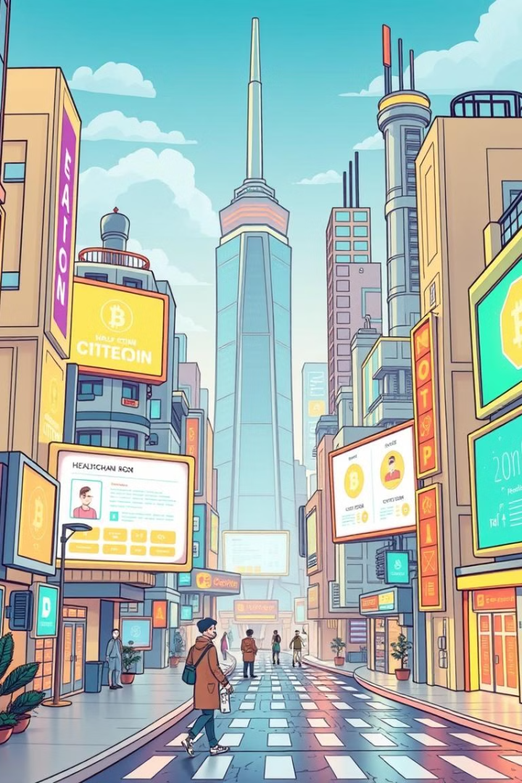
Blockchain Applications and Use Cases
Financial Services
Supply Chain Management
Facilitating cross-border payments, reducing transaction fees, and improving security.
Improving transparency, traceability, and efficiency in supply chains.
Healthcare
Identity Management
Securing patient data, streamlining medical records, and enabling secure data sharing.
Providing secure and verifiable digital identities, reducing fraud and identity theft.

Slide 7
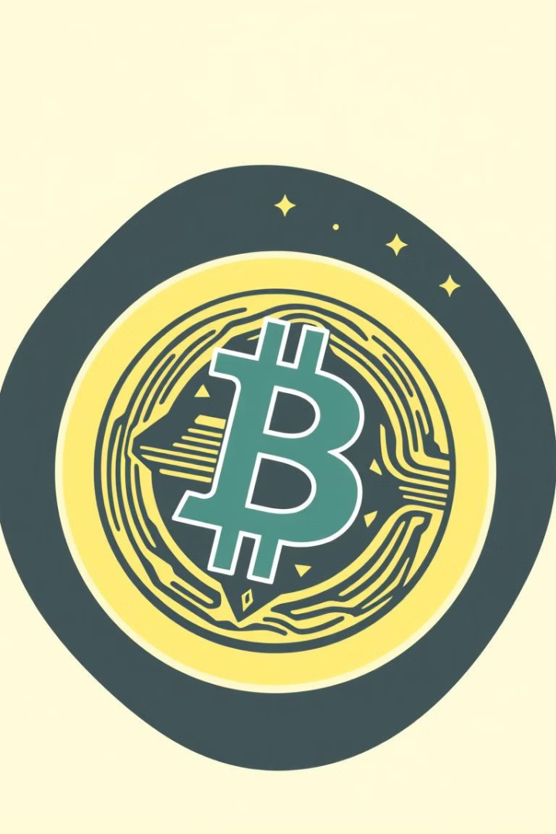
Cryptocurrencies and Digital Assets
Cryptocurrency
Digital asset designed to function as a medium of exchange
Decentralized
Not controlled by any central authority, such as a government or bank
Secure
Protected by cryptography and consensus mechanisms
Examples
Bitcoin, Ethereum, Litecoin

Slide 8
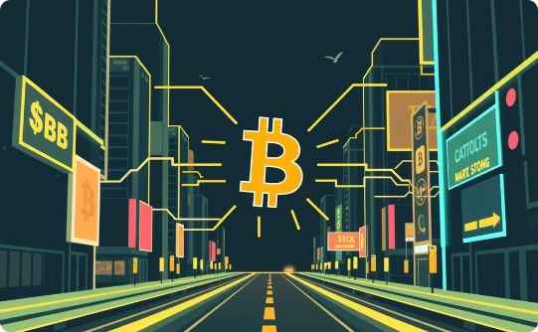
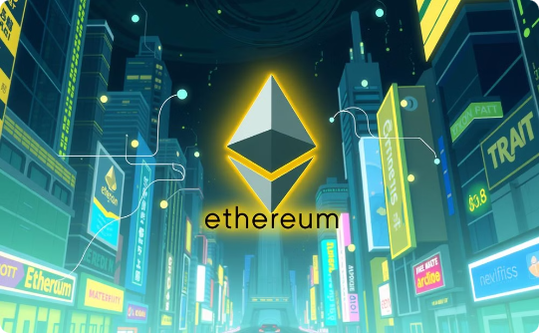

Blockchain Platforms and Protocols
Bitcoin
Ethereum
Hyperledger
The first and most popular cryptocurrency, known for its security and decentralized nature.
A platform that supports smart contracts and decentralized applications, enabling a wide range of use cases.
A collaborative open-source project for developing enterprise-grade blockchain solutions.

Slide 9
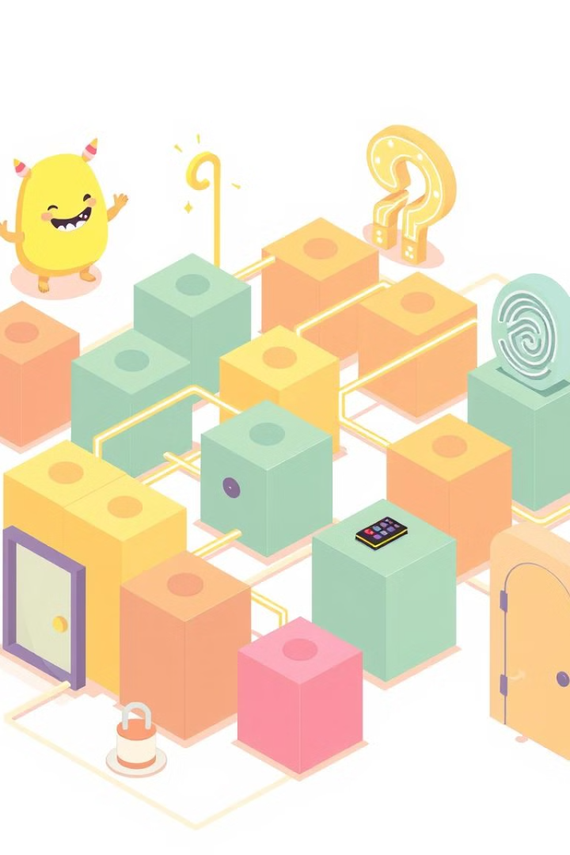




Challenges and Limitations of Blockchain
Scalability
Energy Consumption
Handling a large number of transactions efficiently can be challenging.
Proof-of-work consensus mechanisms can require significant energy resources.
Regulation
Privacy
The lack of clear regulations can create uncertainty and hinder adoption.
Public blockchains can expose transaction details, raising privacy concerns.

Slide 10

The Future of Blockchain Technology
Blockchain technology is evolving rapidly, with ongoing research and development. It has the potential to revolutionize industries, improve efficiency, and enhance security. As the technology matures, we can expect to see wider adoption and innovative applications in diverse sectors.

